Slide 1



General Aviation
Rules & Regulations / Minimum Standards
Update Meeting, November 1st , 2022
Introduction & Meeting Rules
Proposed Rule Making Process Review
Updates since last meeting
Final drafts posted
Comment Process (format)
Next Steps & schedule review
Guidance on Self-Service Labor
Q&A / General Discussion

Slide 2
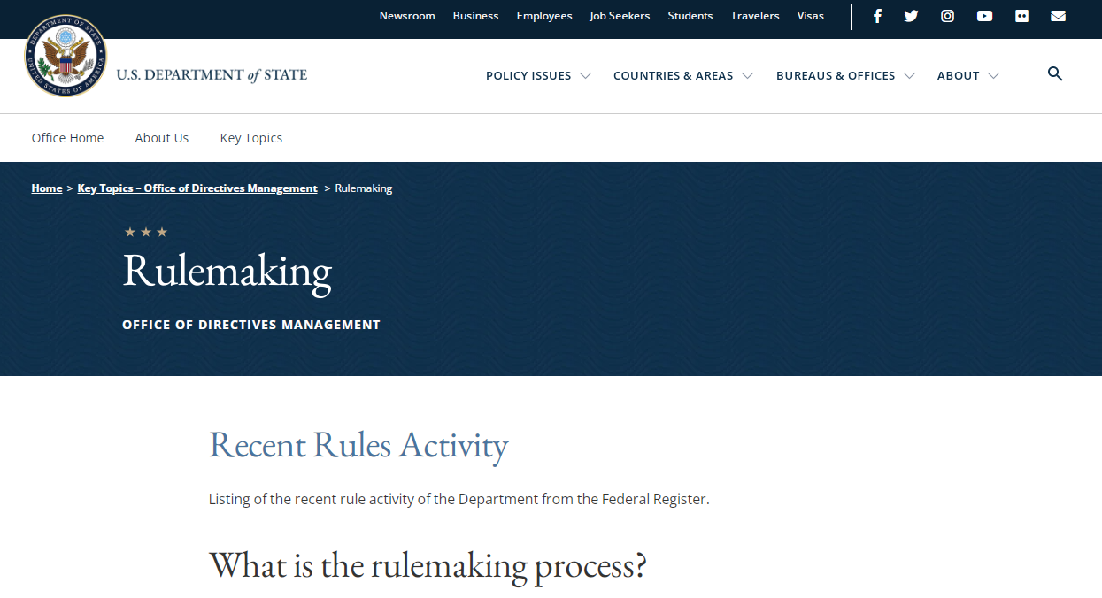


Upcoming Proposed Rule Making
  Ord No. 77-11 and 78-03 Updates coming to:
  1) Airport Rules & Regulations
  2) Minimum Standards
  Review process will exceed the national rulemaking process
  Each document is roughly 40-50 pages & will provide very clear guidance and reference for both the airport & tenants
  Schedule: August 2020 through February 2023
  Sep 1st – Submit draft to the FAA for review
  Nov 1st – Tenant Public Meeting – Unveil draft
  Nov 1st – Dec 1st Public Review and Comment Period
  Dec 15th Tenant / Public Meeting – Final Review
  Jan 16th – BOCC Public Hearing Request
  Feb 6, 2023 – BOCC Public Hearing

Slide 3
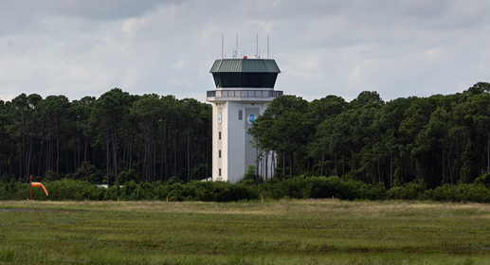
Updates & Review Process
  Received comments from the FAA
  - Legal counsel reviewed / addressed
  Clarification for Self-Service Labor Requirement
  Final Airport drafts complete
  Final drafts posted for public review Nov 1st
  Public Review Period = Nov 1st – Dec 1st 2022
  Comment Form – Format and Process
    Submit all comments by December 1, 2022
    Send comments to PublicComments@flyVPS.com

Slide 4
Document Locations / Remaining Schedule
Public Notices – FlyVPS
Notices (flydts.com)
Notices (flycew.com)
  Remaining Program Schedule
  Dec 15th Tenant / Public Meeting – Final Review
  Jan 16th – BOCC Public Hearing Request
  Feb 6, 2023 – BOCC Public Hearing

Slide 5

Q & A – General Discussion
      QUESTIONS / COMMENTS
PublicComments@flyVPS.com
850-651-7160 ext. 4

